Slide 1
ADCS:
Arduino & Simulink

Slide 2
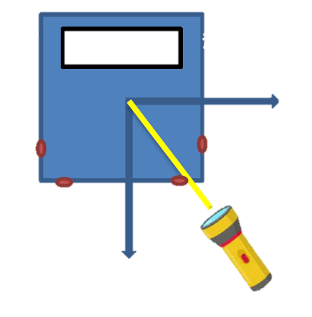



Requirements
Determination
Control
Determine direction of a unique light source
Need to show the light incident angle in an LCD screen. At least in the $xy$-plane
Orient the satellite’s X+/X- faces to a dynamic light source
Minimise time to achieve orientation
Maximise precision
Control should be a 2nd mode of operation, activated by the push of a button
Avoid oscillations
Minimise components, cabling….
The design of a control law and a complete Simulink model is encouraged
Use a filter to improve the stability of the measurement
$$x$$
$$y$$

Slide 3
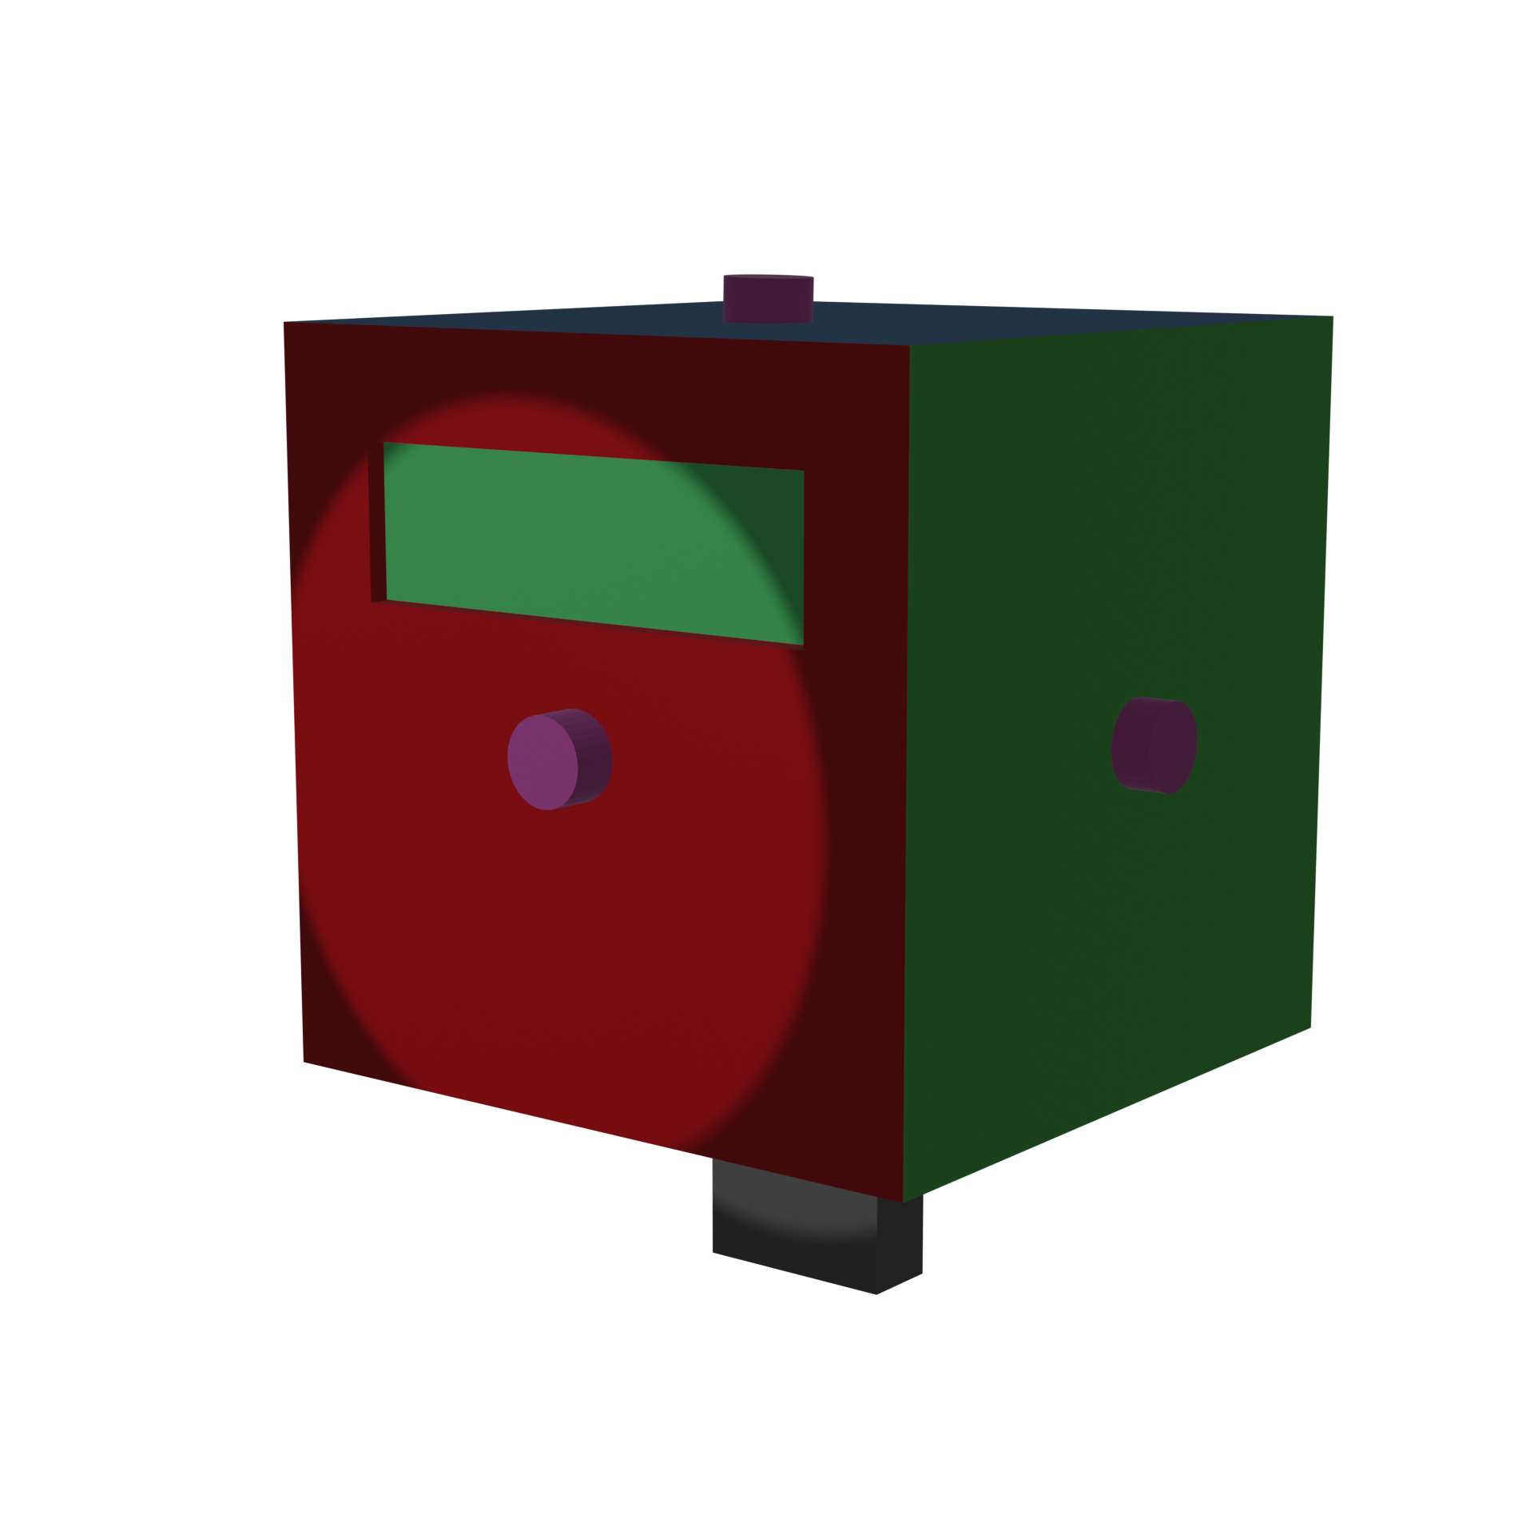
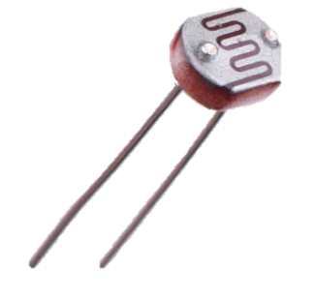
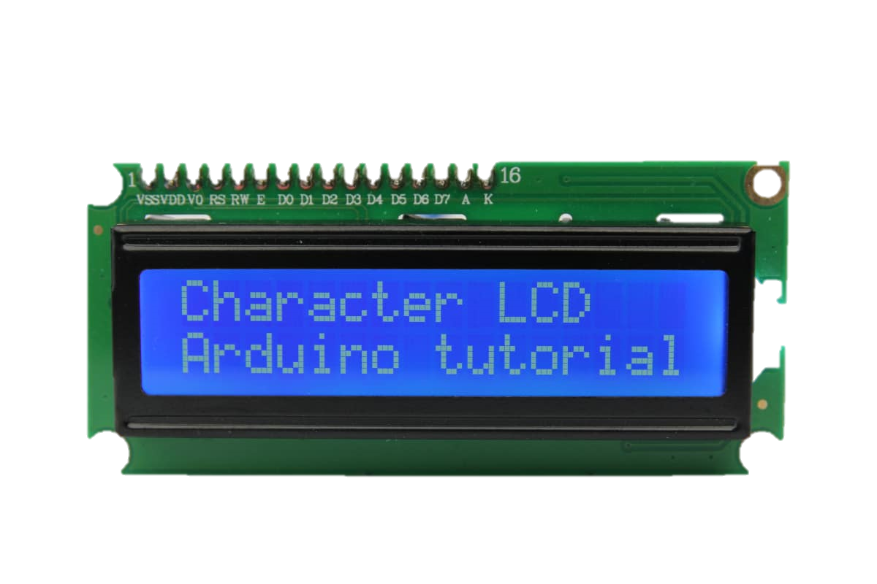
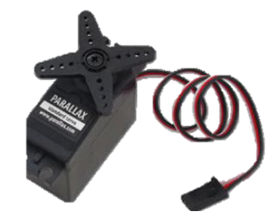

Components and Design
Components
Photoresistors
How many?
LCD screen
Battery
Servo motor
Design
Need to determine the light incident angle at all times ← this drives decision for n. photoresistors
Control only in $xy$-plane?
What about the structure? + need to 3d print it + needs to be light

Slide 4
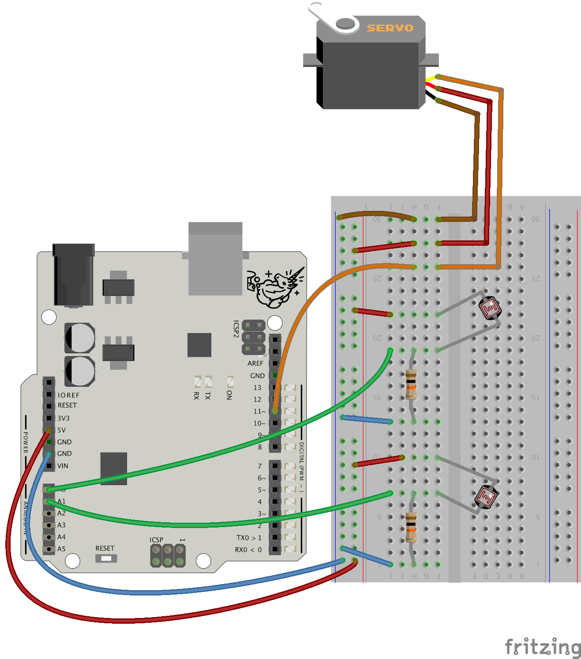
Circuit
Servo motor
Algo así….
Hay que pensar el n de resistors…
Photoresistors

Slide 5
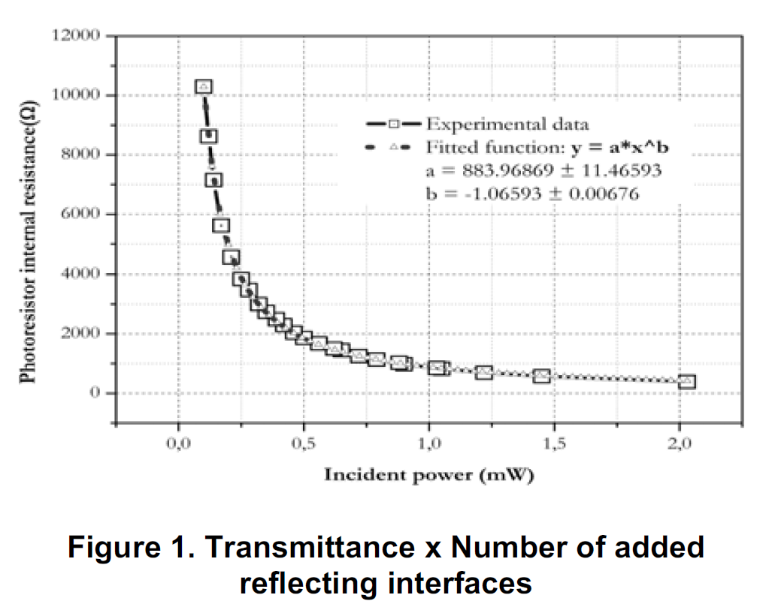
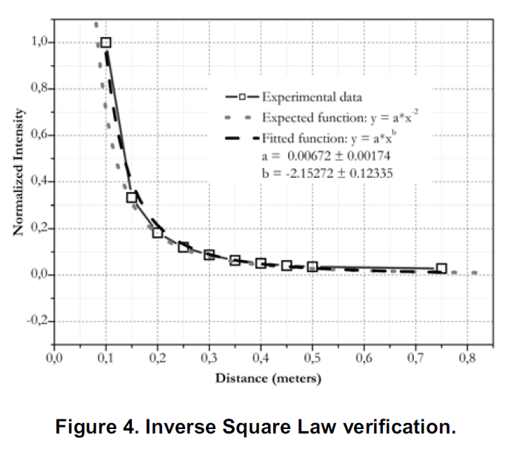
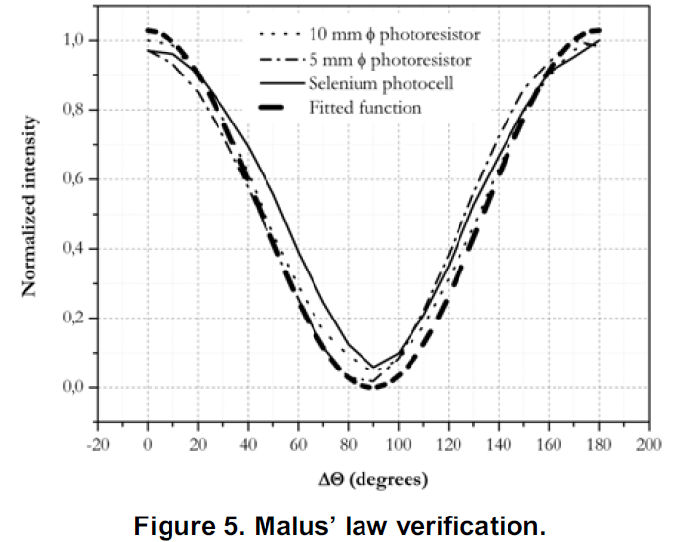
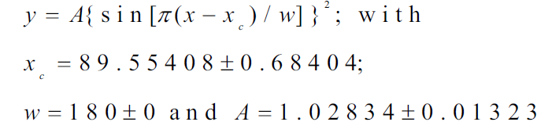
Photoresistors
R = f(β, I)
Model
Dependent parameters:
Sun incidence angle
Intensity
Dependent on distance
Dependent on light source (cte.)
Source: Some_Simple_Experiments_in_Optics_Using_a_PhotoRes

Slide 6



Servo motor
Model
φ = f(V)
The angle of rotation (0-180 degrees) depends on the input voltage to the servo motor
Include turn velocity in the model. How?
Translate angle into body axis. ← Use quaternions? Tbf the angle will only be in the $xy$-plane if 1 servomotor is used. ← Should we use 2 servos?
$$y$$
$$x$$

Slide 7



Structure
Requirements
Needs to turn 180 degrees to face the light
Needs to determine the light incidence angle in at least $xy$-plane. Preferably in 3 axis.
Photoresistors
Also…
Need to have holes for the photoresistors, and these need to be held by it without moving
The structure needs to be light enough for the servomotor to be able to move it
$$y$$
$$x$$

Slide 8





Control Law
PID? Or PD to make it simpler
$$y$$
$$y$$
$$x$$
$$Θ$$
$$x$$

Slide 9
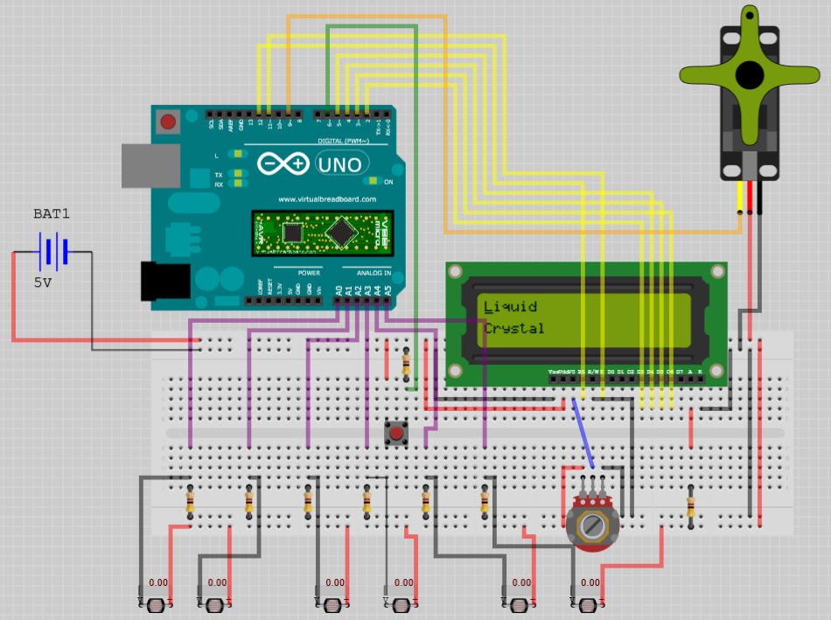

Slide 10
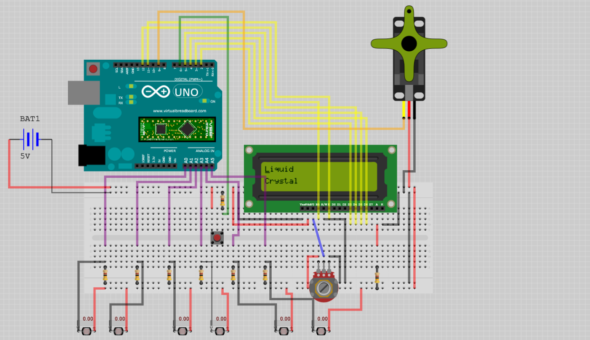
Servomotor
Arduino Uno
Battery
LCD
Button
Potentiometer
Phototransistors

Slide 11
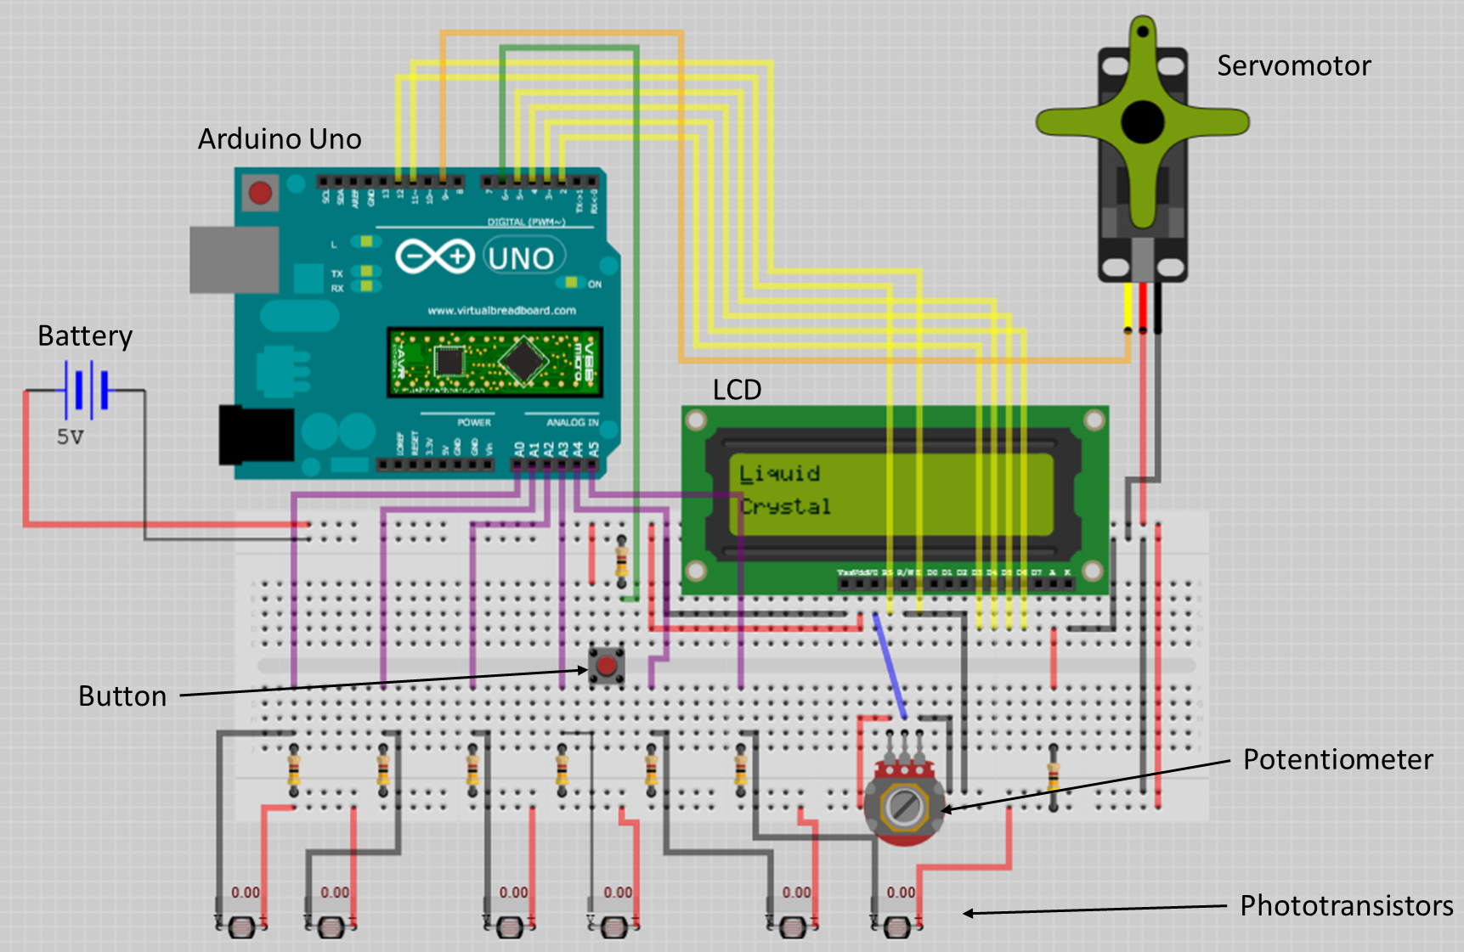

Slide 12
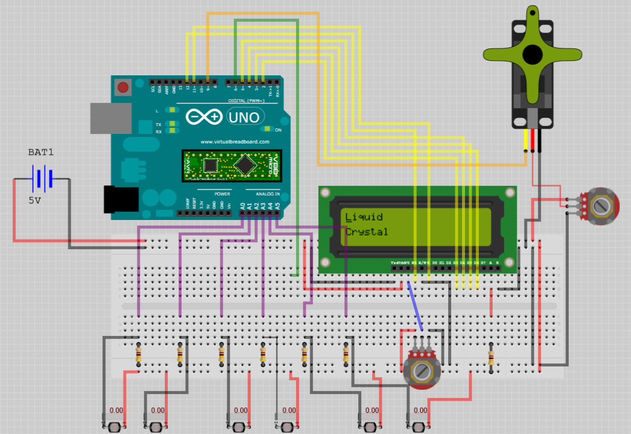
Servomotor
Arduino Uno
Battery
LCD
LCD
Phototransistors
Potentiometer

Slide 13
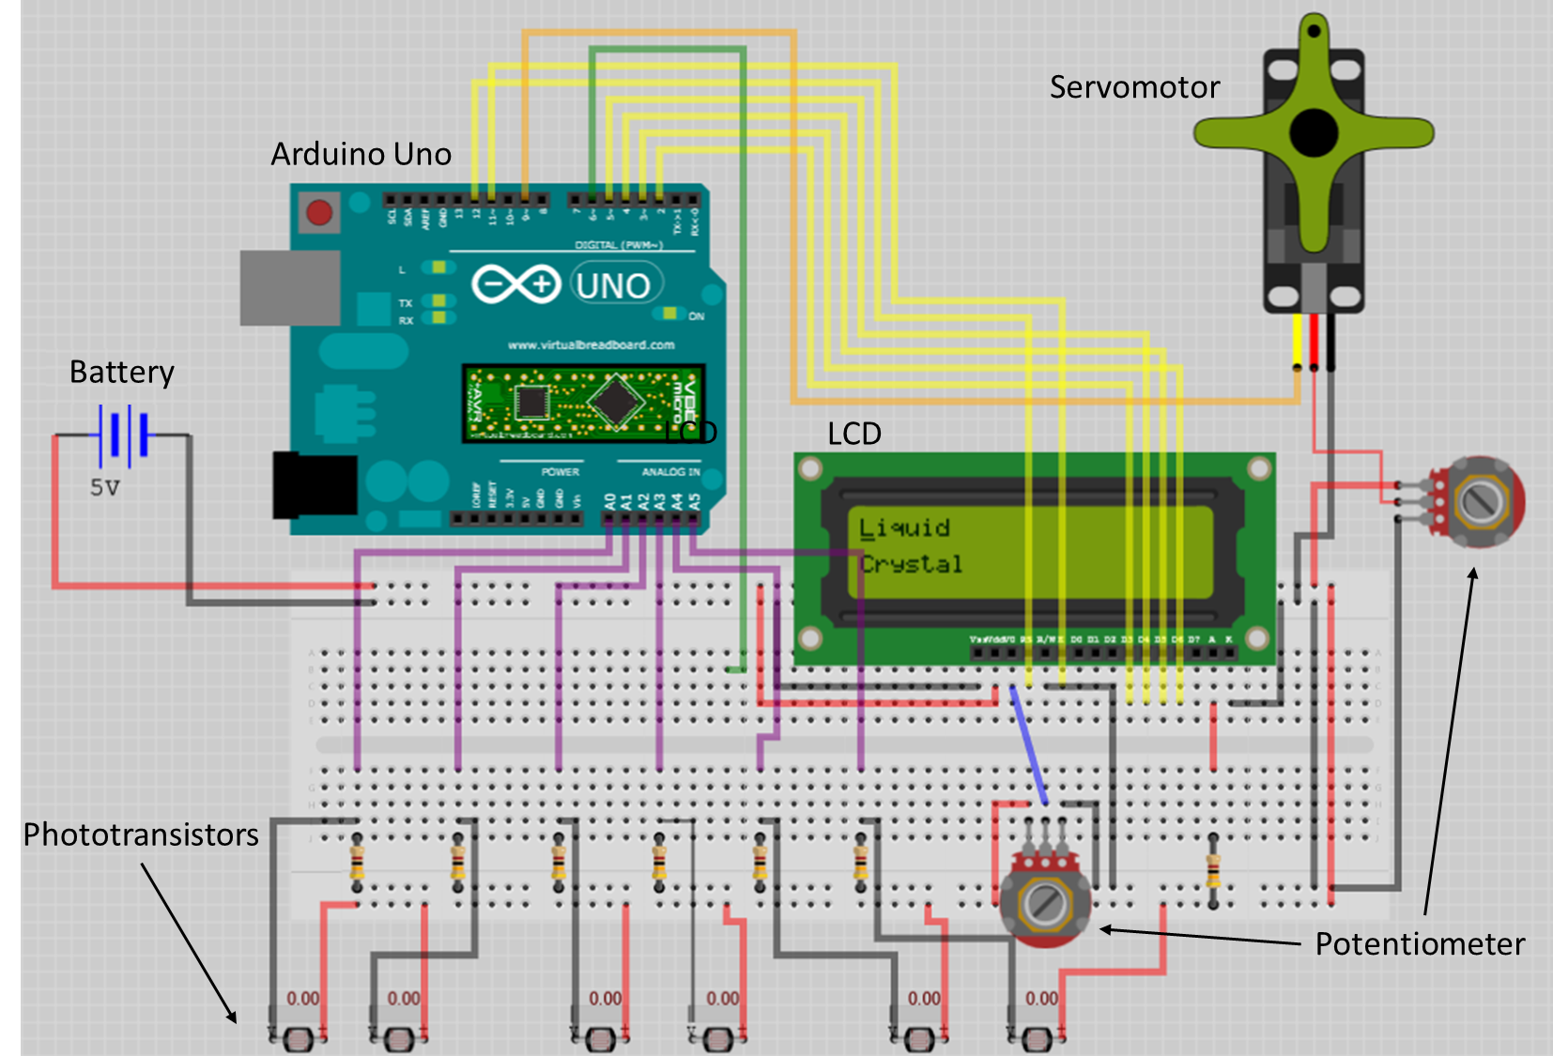

Slide 14
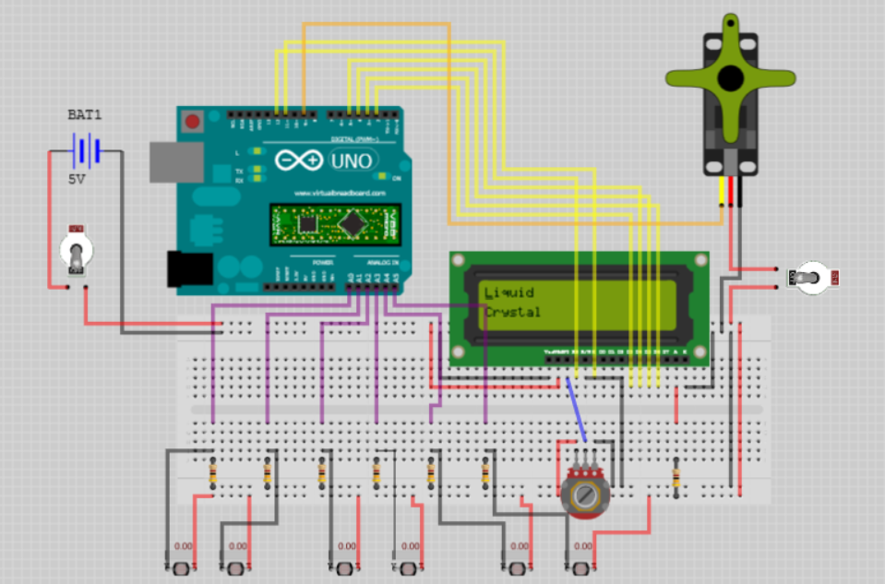

Slide 15
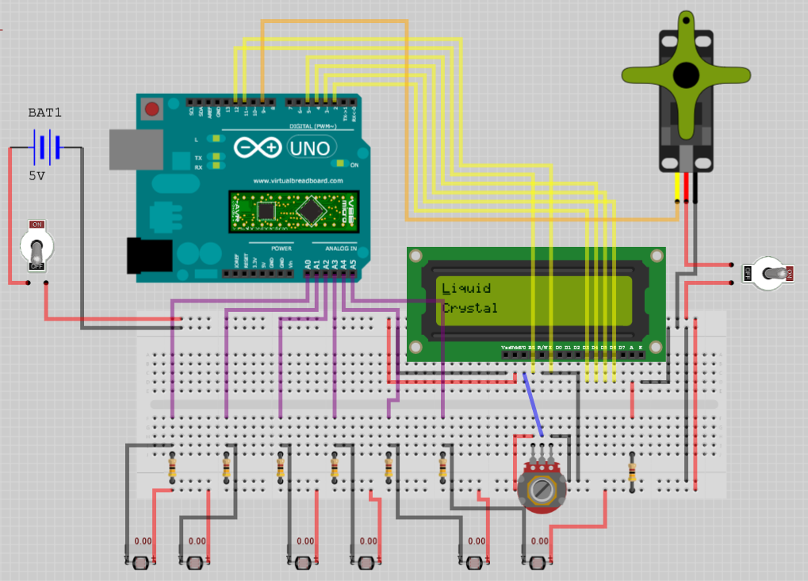
Servomotor
Arduino Uno
Battery
LCD
Switch
Switch
Phototransistors
Potentiometer

Slide 16
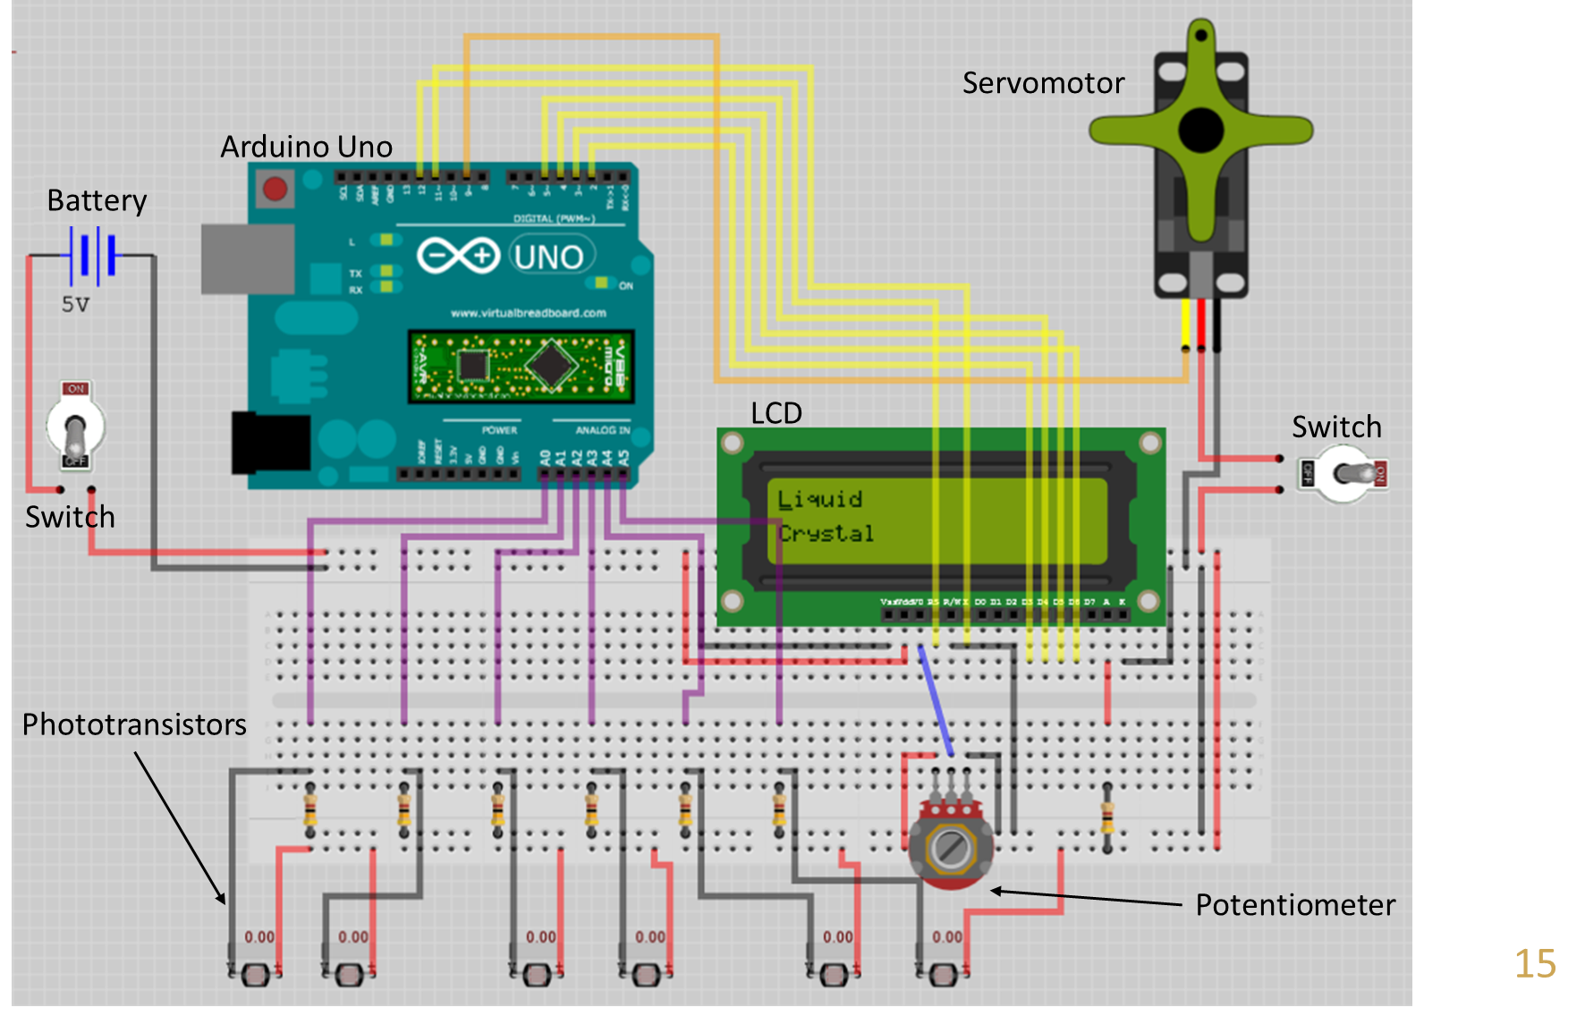

Slide 17
Programming options
Program everything in Simulink?
Pros: works for sure
Cons: I hate simulink
Program the control law in Simulink and the rest in Arduino (C++), include the control law as a void control{} or something….
Pros: can use the Arduino libraries. i.e. servo library ← allows to get the turn angle very easily
Cons: need to combine the code generated by Simulink with our own code. Could be problematic
Program everything in Arduino <- NO!

Slide 18
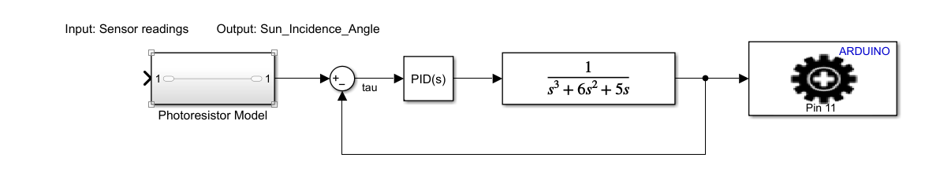
Simulink
This should work (if the PID is properly tuned), but it is not taking into consideration a model for the servo
The servomotor should be modelled instead of using the built in functions. This could be achieved by sending a specific voltage signal to the digital pin to which the servo motor is connected to.

